Slide 1
SECURE DATA HIDING IN IMAGES USING STEGANOGRAPHY
CAPSTONE PROJECT
Presented By: Aalok Vinod Sharma
Student Name : Aalok Vinod Sharma
College Name & Department : KCE’S Institute of Management and Research , Jalgaon.

Slide 2
OUTLINE
Problem Statement
Technology used
Wow factor
End users
Result
Conclusion
Git-hub Link
Future scope

Slide 3
Problem Statement
The challenge lies in ensuring high security, imperceptibility, and robustness against attacks like image compression, noise, and steganalysis.
This project aims to develop a steganographic technique that enhances data hiding while maintaining image quality and resistance to unauthorized detection or modification.
The solution must also ensure efficient embedding and extraction, making it suitable for secure communication in cybersecurity applications.

Slide 4
Technology used
Libraries Use in this project :-
Cv2 :- The cv2 library is used for working with images in this project.
Os :-For File and Directory Operations and this library is used to interact with the operating system.
String :- is useful for handling text before hiding it in images.

Slide 5
Wow factors
Multi-Layered Security: Encryption + Steganography :-
Instead of just hiding plain text, first encrypt the data and then embed it in an image.
Even if someone extracts the hidden data, they can’t read it without the encryption key.
Secret Key-Based Access (Only Authorized Users Can Extract) :-
Add an authentication layer where only users with the correct key/password can extract hidden data.

Slide 6
End users
Cybersecurity Professionals & Ethical Hackers
Government & Intelligence Agencies
Corporate & Business Professionals
Cybercrime Investigators & Law Enforcement
Researchers & Academicians
Cyber Defense Teams

Slide 7
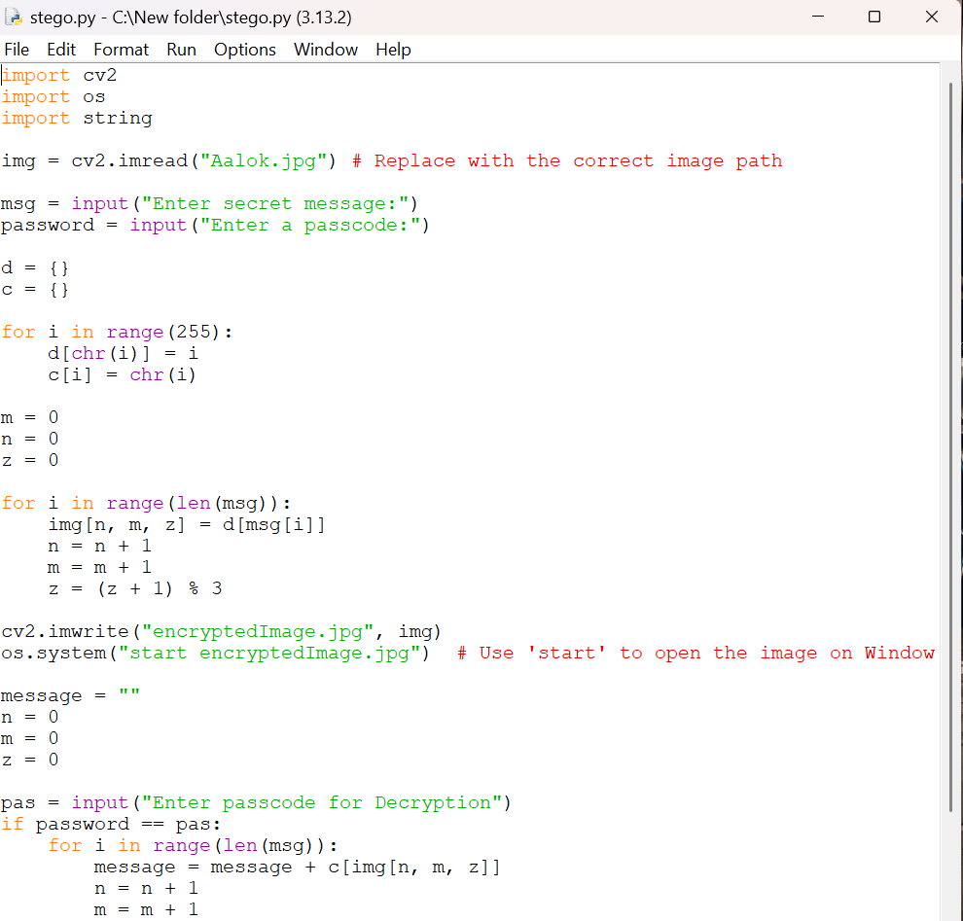
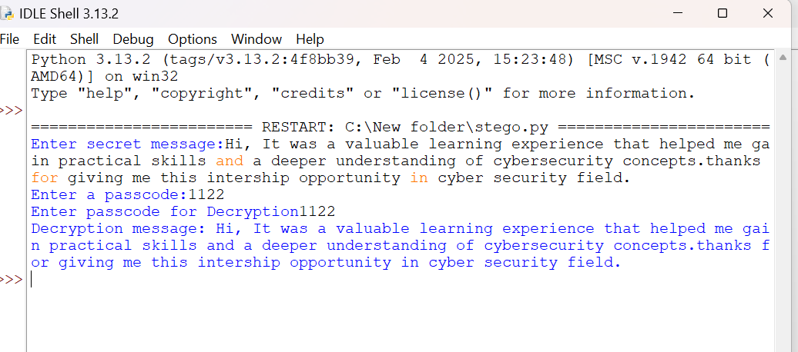
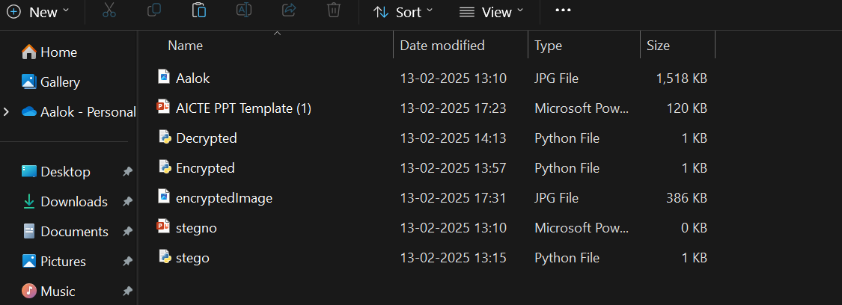
Results

Slide 8
Conclusion
Steganography is a powerful technique for secure data hiding, ensuring confidential information remains hidden in plain sight. This project demonstrates how images can be used as a medium for secret communication, making it a valuable tool in cybersecurity, digital forensics, and private communications.
With the increasing risk of data breaches and cyberattacks, steganography provides an innovative solution for secure communication. Future improvements, such as AI-driven security, time-based self-destructing messages, and network-based steganography, can further enhance its effectiveness in cybersecurity.
Final Thought: "Steganography isn’t just about hiding data—it’s about securing the future of private communication in the digital world."

Slide 9
GitHub Link
https://github.com/Aalok-Sharma1/project-aicte.git
https://github.com/Aalok-Sharma1/project-aicte

Slide 10
Future scope(optional)
Use machine learning & deep learning to generate stego-images that are undetectable by AI-based steganalysis.
AI can also be used to improve embedding efficiency while reducing distortion in images.
Use blockchain to verify the authenticity of stego-images and ensure tamper-proof communication.
Can be used for secure military or intelligence communication without being detected.

Slide 11
THANK YOU

